Slide 1
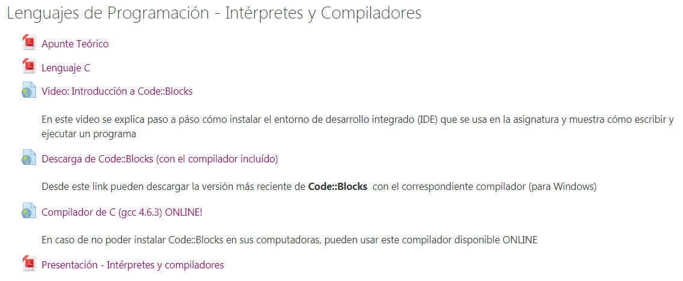
Compilador C online
https://repl.it/languages/c

